Slide 1

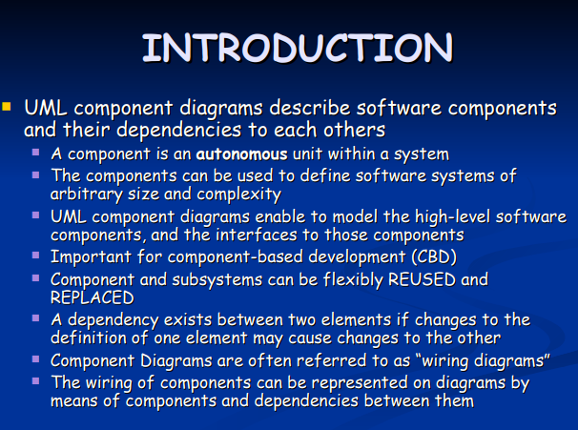
18CSC202J - OBJECT ORIENTED DESIGN AND PROGRAMMING
Session 12
Topic : UML Component Diagram, Deployment Diagram

Slide 2
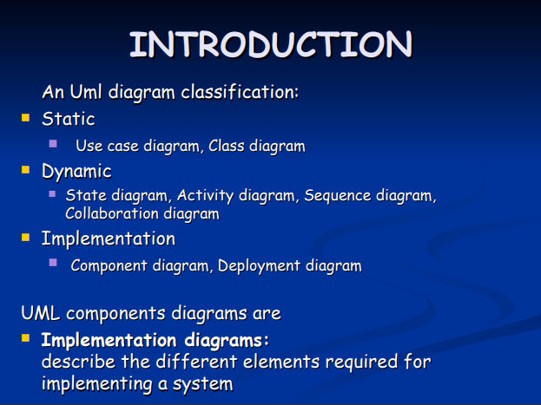

Slide 3
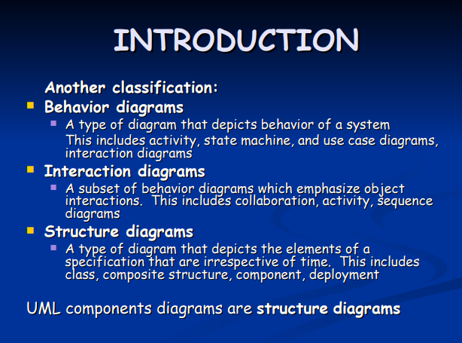

Slide 4
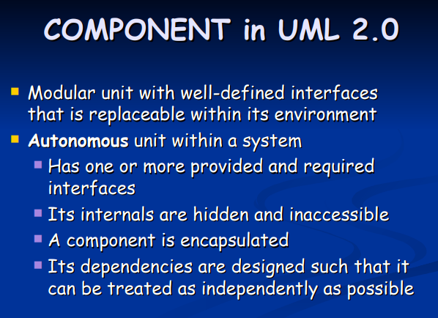

Slide 5
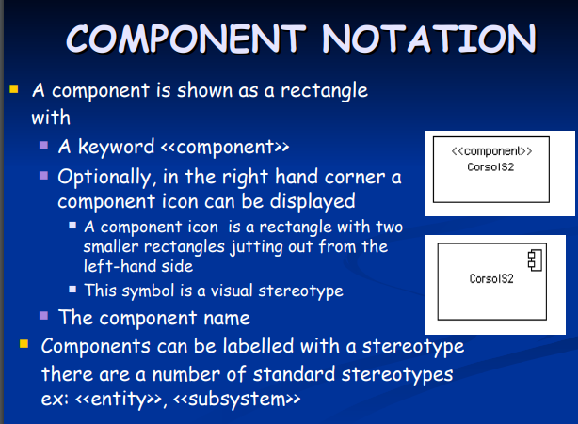

Slide 6
Guidelines to Draw: Component Diagram
Based on the analysis of the problem description of the system, identify the major subsystem.
Group the individual packages and other logical entities in the system to provide as separate components.
Then identify the interfaces needed for components interaction.
If needed, identify the subprograms which are part of each of the components and draw them along with their associated components.
Use appropriate notations to draw the complete component diagram.

Slide 7


Notations
S.NO | NAME | SYMBOL | DESCRIPTION
1 | Component |  | Component is used to represent any part of a system for which UML diagrams are made.
2 | Association |  | A structural relationship describing a set of links connected between objects.

Slide 8
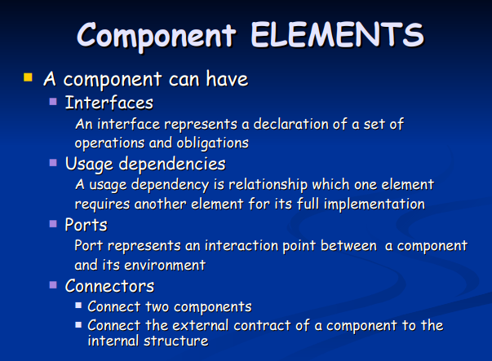

Slide 9
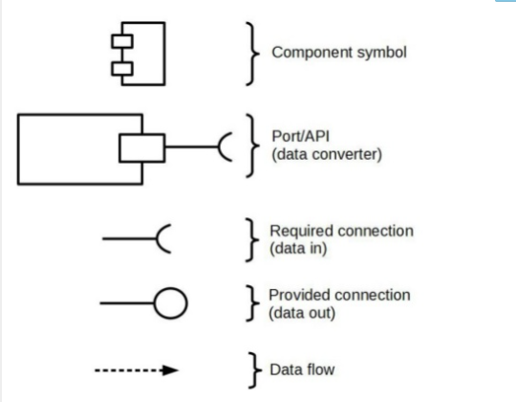
Notations

Slide 10
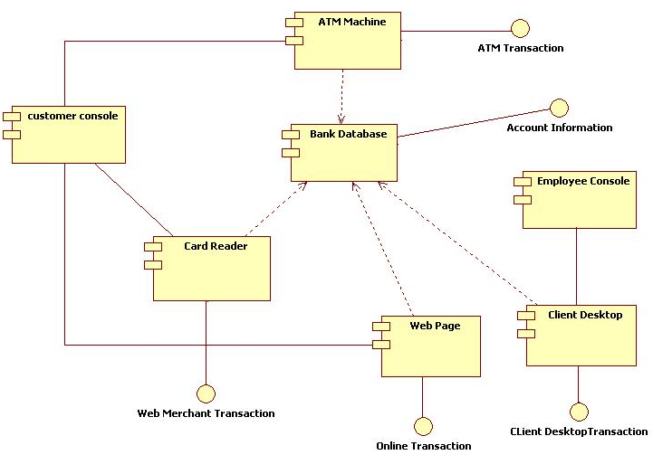
Example

Slide 11
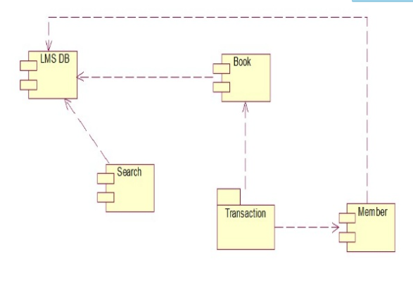

Slide 12
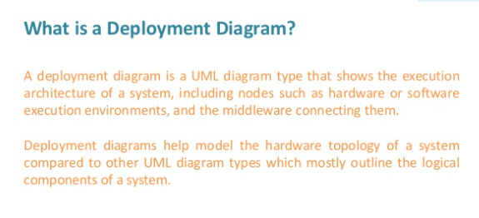
Deployment Diagram

Slide 13
Purpose
Purpose of Deployment Diagrams
They show the structure of the run-time system
They capture the hardware that will be used to implement the system and the links between different items of hardware.
They model physical hardware elements and the communication paths between them
They can be used to plan the architecture of a system.
They are also useful for Document the deployment of software components or nodes

Slide 14
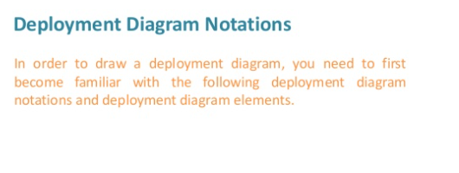

Slide 15
How to Draw a Deployment Diagram?
Deployment diagram represents the deployment view of a system. It is related to the component diagram because the components are deployed using the deployment diagrams. A deployment diagram consists of nodes. Nodes are nothing but physical hardware used to deploy the application.

Slide 16
Deployment diagrams are useful for system engineers. An efficient deployment diagram is very important as it controls the following parameters −
Performance
Scalability
Maintainability
Portability
Before drawing a deployment diagram, the following artifacts should be identified −
Nodes
Relationships among nodes

Slide 17
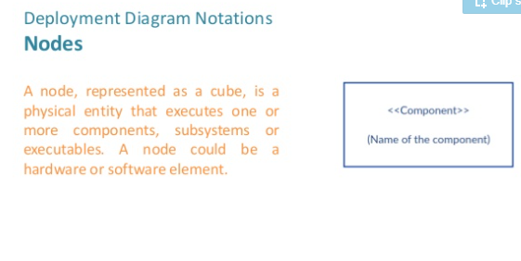

Slide 18
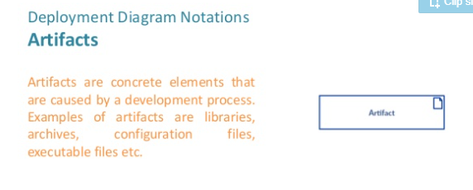

Slide 19
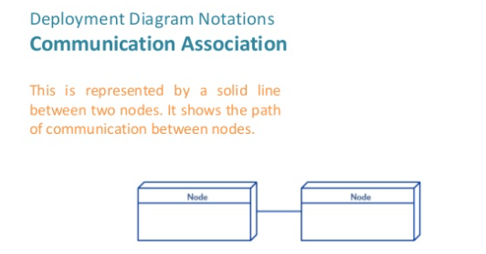

Slide 20
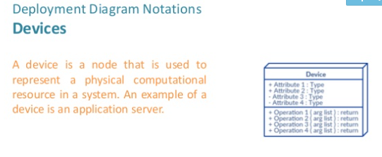

Slide 21
Deployment diagrams can be used −
To model the hardware topology of a system.
To model the embedded system.
To model the hardware details for a client/server system.
To model the hardware details of a distributed application.
For Forward and Reverse engineering.

Slide 22
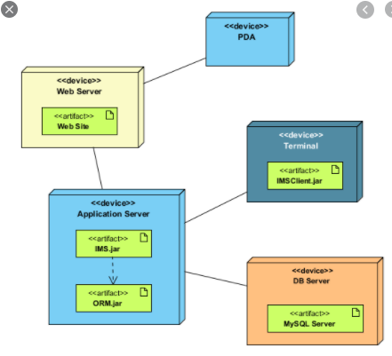

Slide 23
Harsh HR of a Google HQ in Bangalore is looking for the automated appraisal management system. The current salary of the employee is fixed and based on the results of the performance monitoring software the appraisal management system have to revise the salary of the employee. Use the Contructor Overloading Concept to develop automated appraisal management system. The Default Salary of employees is 30000. sal=30000 Mandatory: 1.Create a new class named "Appraisal" 2.Create a constructor for the class "Appraisal" 3.Create a variable name "sal" to get the default salary and also get the new salary of the employee. 4.Create a object named "myobj" and "myobj2" for the class "Appraisal" in the main class. 5.Access the "Appraisal" class from the main class to print the current salary and the revised salary of the employee.
INPUT33000
OUTPUT
Old Salary:30000 New Salary:33000

Slide 24
When we travel positive distance means travelling forward and negative means travelling backwards. Your task is to overload the unary + and unary - operator to display the same. Mandatory: 1.Create a class Distance(feet,inches) 2.Overload operator - to calculate distance traveled backwards 3.Overload operator + to calculate distance traveled forward 4.Create a method named "displayDistance" to display the traveled distance. Input : First Line contains Distance(Feet and Inches separated by space)

Slide 25
Varun the maths teacher assigned his students the task of finding the average of numbers but he imposed some of the constraints in doing that. Can you help the students to complete their task?? Mandatory: 1. Create an Abstract class as "parent" 2. Declare a virtual function as public member as following: Hint : virtual float average(int a, int b, int c)=0; 3. Create a child class as "derived" by inheriting "parent" class Hint : class child:public parent 4. Define the average() function in Derived class with two parameter a. Function Name = average() b. Return type = float() c. Argument = Three argument of type integer d. Usage = To add three values, find the average and return the value to main function. In main method: 1.Create pointer instance for base class: parent *p; 2. Create an instance for derived class: child c; 3. Assign the address of d to pointer b: Hint: p=&c; 4. Declare three variable and read it: Hint: int a,b,c; cin>>a>>b>d; 5. Call the sum function using: Hint: p->average(a,b,cd) and print the result.

